Slide 1

cc
Team-6
Divyaraj → Docker & K8s.
Sanatan → AWS & Terraform.
Parmeshwar* → Ansible & Docker.
Priya → Terraform & AWS.
Shreya → Jenkins & Ansible.

Slide 2
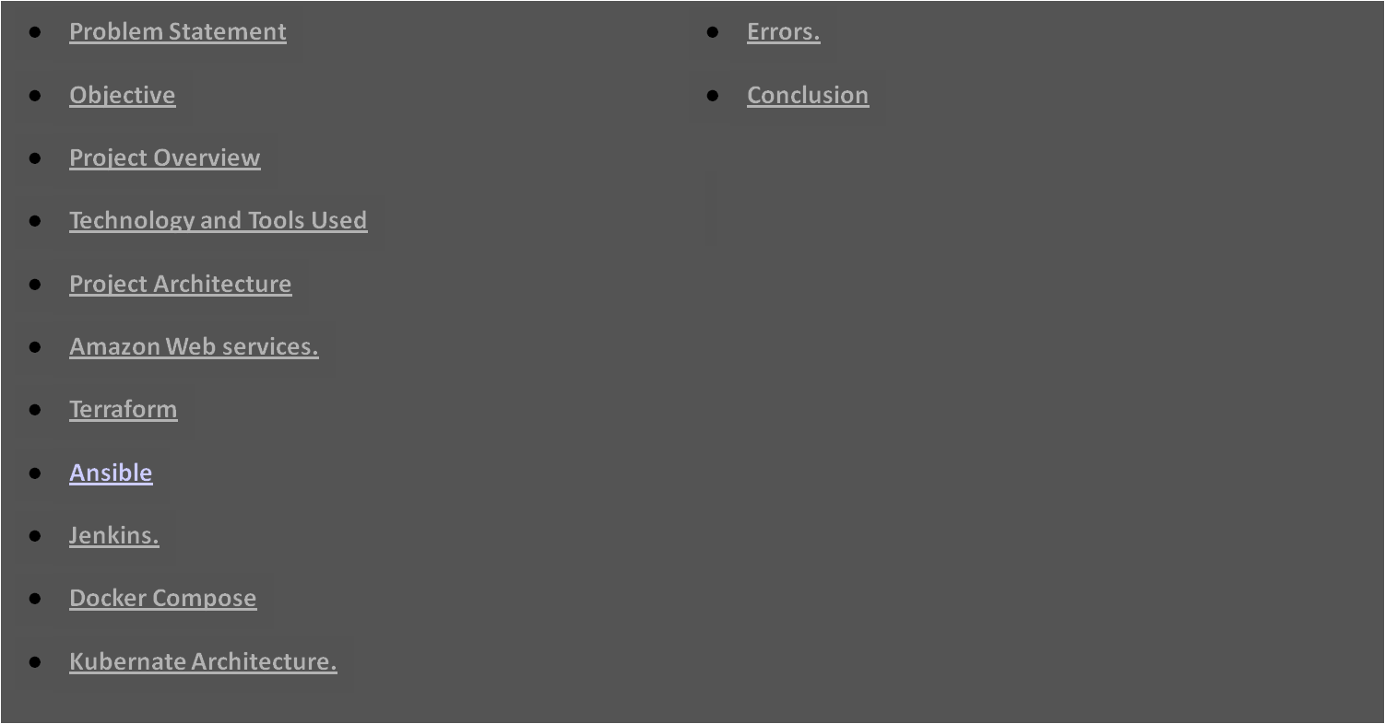
Outline
9

Slide 3
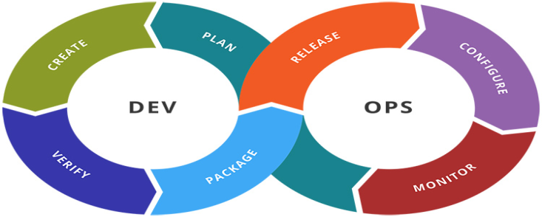
Problem Statement
c
Design and deploy tasks required to build CICD pipeline for BookMySlot application on cloud platform as a set of micro services on containerized platform such as docker and Kubernetes. Provision Infrastructure using terraform on aws, and configure same using Ansible.

Slide 4
c
OBJECTIVE
Our objective is to provide best deployment service on server (Cloud) for BookMySlot Application.

Slide 5
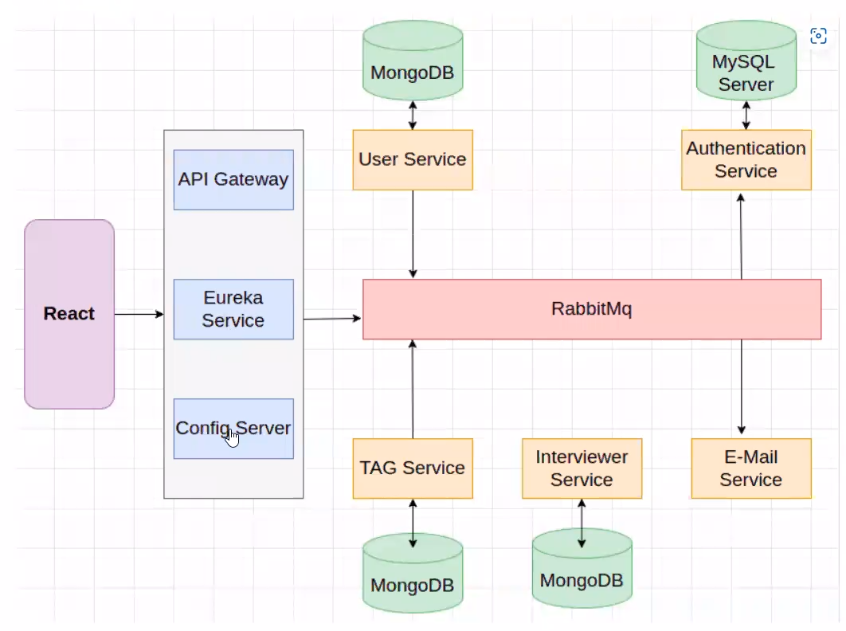
c
Project Overview
Sign up

Slide 6






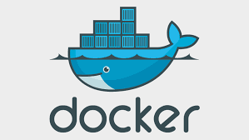

Technologies and Tools Used
c

Slide 7




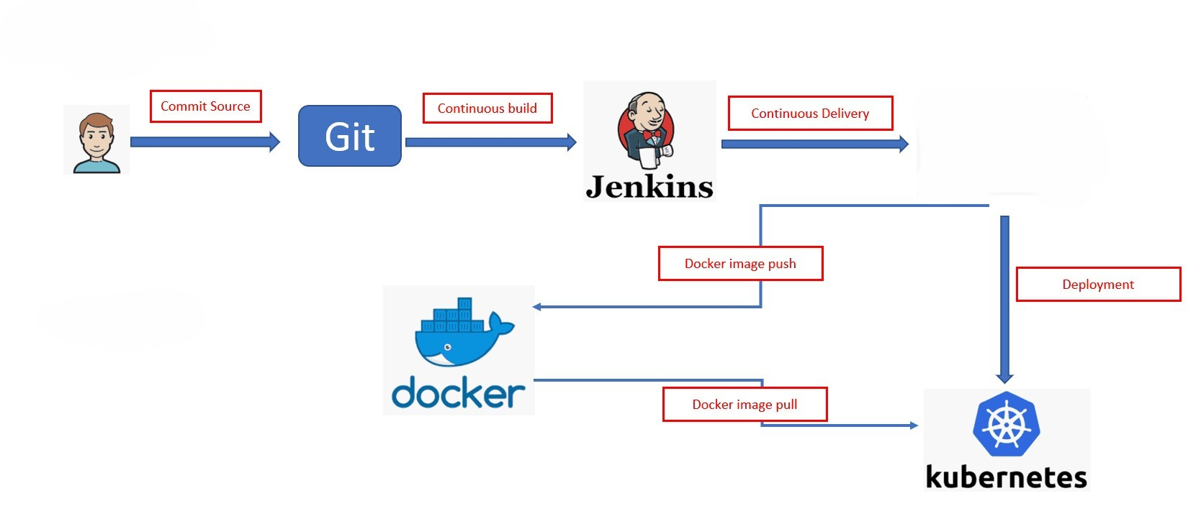

Project Architecture
c
Cloud
IaC
Configuration

Slide 8



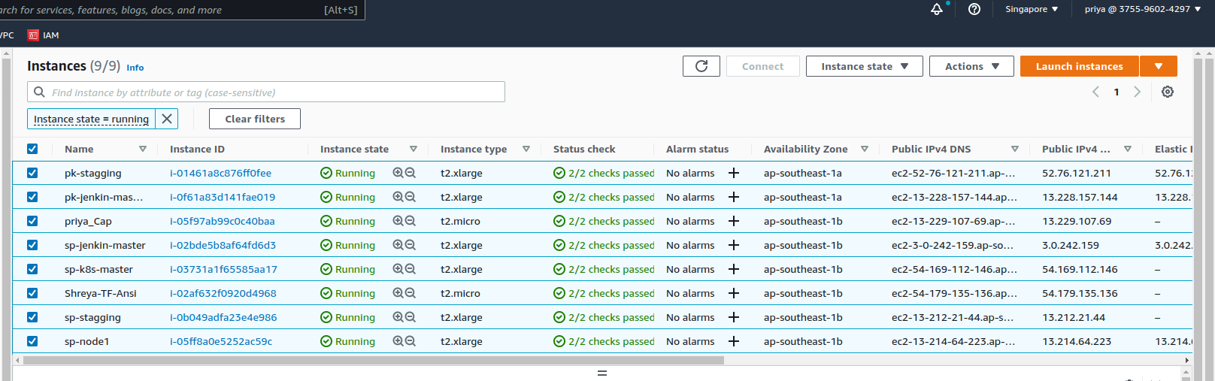
Amazon Web Service
c

Slide 9
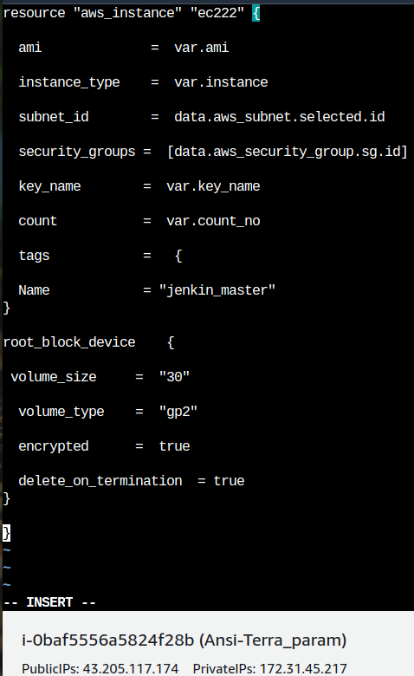
TERRAFORM
c
  Terraform has all necessary tooling for configuring servers and provisioning infrastructure.
  Terraform is an immutable infrastructure tool.
  It is a flexible tool.

Slide 10
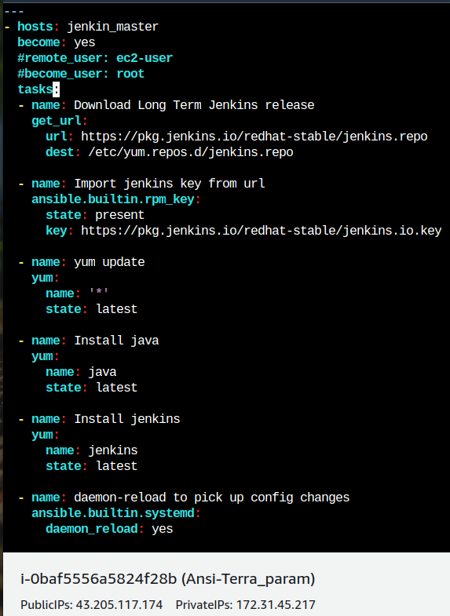
Ansible
c
  Ansible is an open source IT Configuration Management tool.
  It aims to provide large productivity gains to a wide variety of automation challenges.
  Works on Push Mechanism
  Flexible and Agentless.

Slide 11
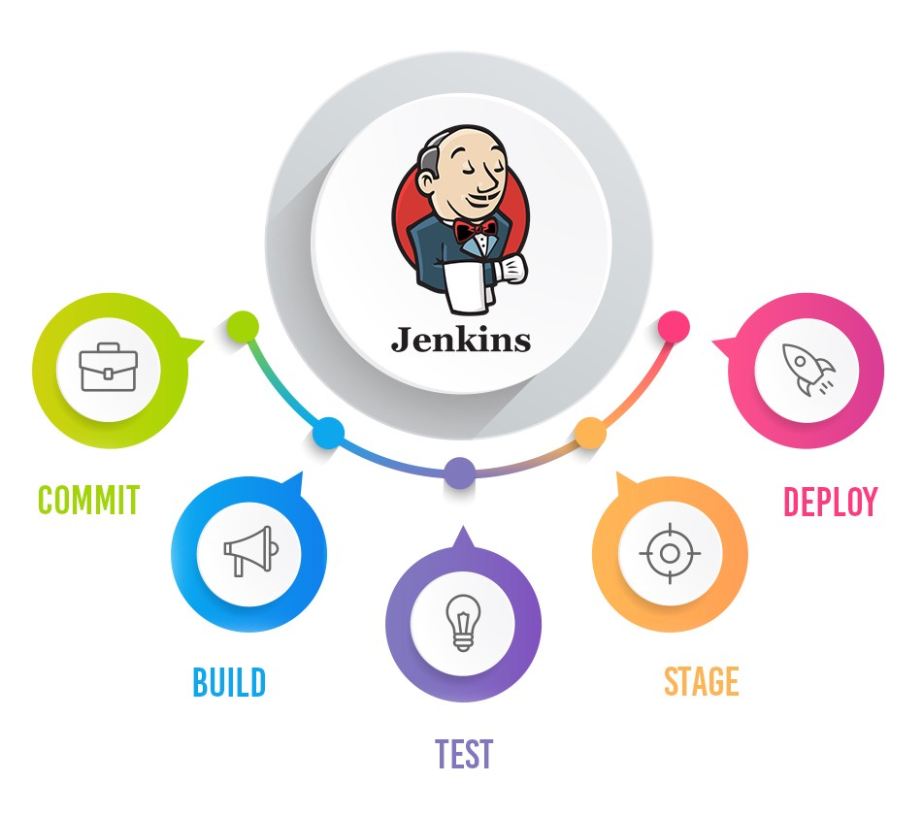
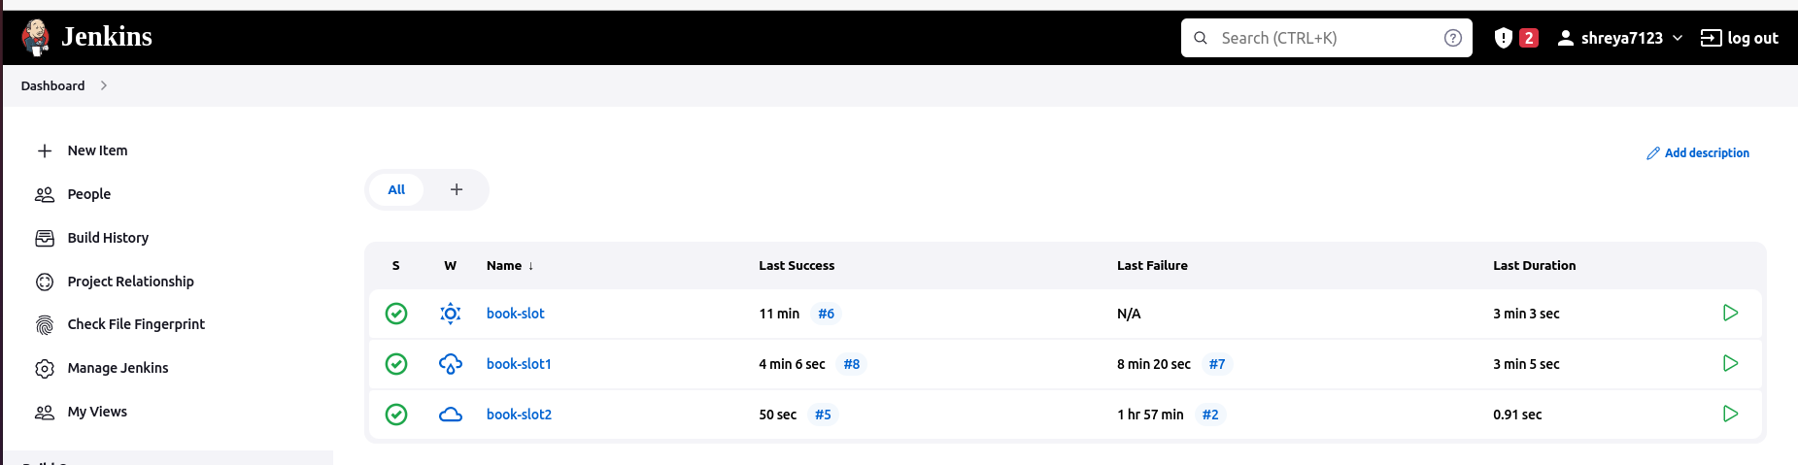
c

Slide 12
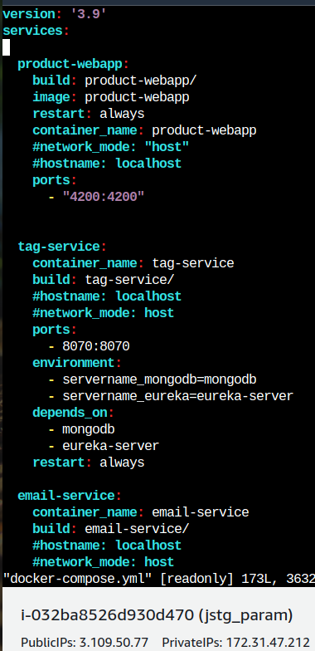
Docker-Compose
c
Compose is a tool for defining and running multi-container Docker applications.
With Compose, you use a YAML file to configure your application's deployment and services.

Slide 13
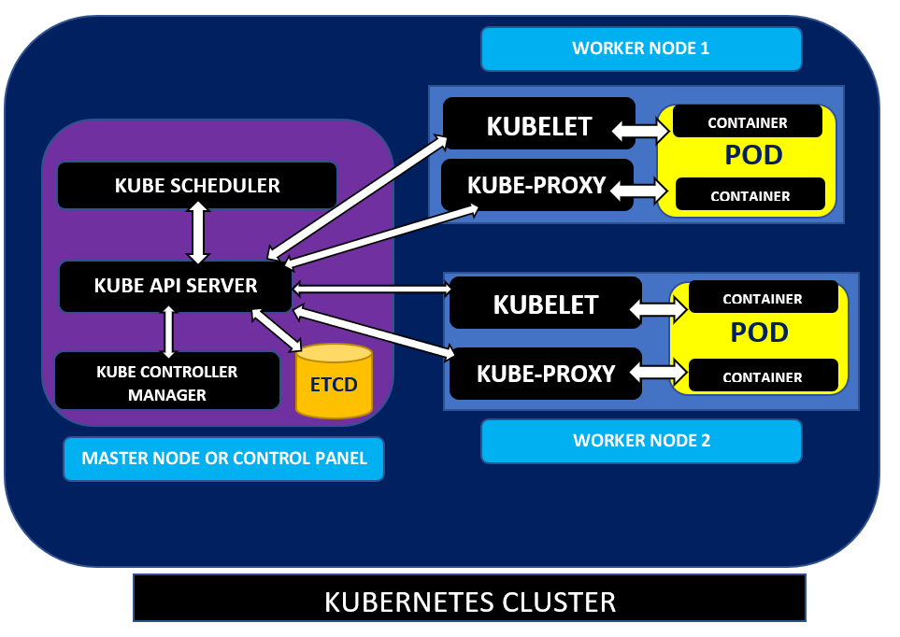
Kubernetes Architecture
c
Advantages of Kubernetes:-
  Kubernete Automates
  Containerized Environments.
  Scaling Up and Down.
  Strong Open Source
  Communities.
  Improve Developer
  Productivity.

Slide 14
Errors faced
c
1) ApiGatewayApplicationTests.contextLoads » Failed to load Application.
Soln: Maven Plug-in added into pom.xml of Api_Gateway
2) Cross-Origin error while sign Up
Soln: this appln deployed with diff domain name we changed that domain with our domain(IP).
3) Containerd-shim-runC-v2 file was missing
Soln: installed the containerd package once again using ( yum reinstall container docker )
4) permission denied to var/run/docker.sock
Soln: permission given to docker.sock using (chmod 665 cmd)

Slide 15

Conclusion
c
We have Successfully deployed BookMySlot application using the Devops tools.

Slide 16


c

